Slide 1



Welcome you all
Course: CSS
Day 6 (Session 1)
Box Shadow
R.SUREKHA
Technical Trainer,
KG Micro College
KGiSL Campus, Coimbatore – 641 035.

Slide 2


Slide 3
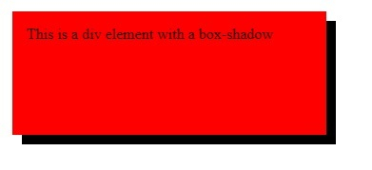
CSS box-shadow Property
What is box-shadow property?
The box-shadow property attaches one or more shadows to an element.
Example:
div {
width: 300px;
height: 100px;
padding: 15px;
background-color: red;
box-shadow: 10px 10px;
}

Slide 4
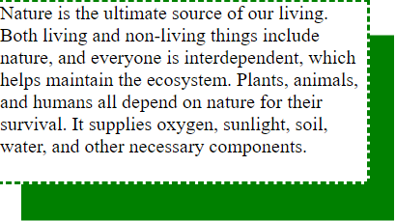
div{
height:20vh;
width:20%;
margin-left:500px ;
border:3px dashed green;
box-shadow:20px 30px green;
}

Slide 5
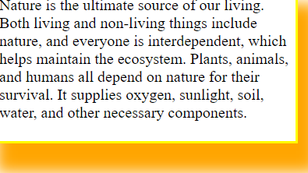
border:3px solid yellow;
box-shadow:10px 20px 15px 10px orange;

Slide 6
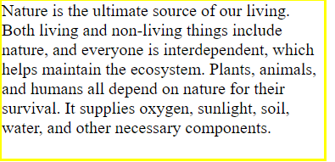
border:3px solid yellow;
box-shadow:10px 20px 15px 10px orange;
box-shadow: none;

Slide 7
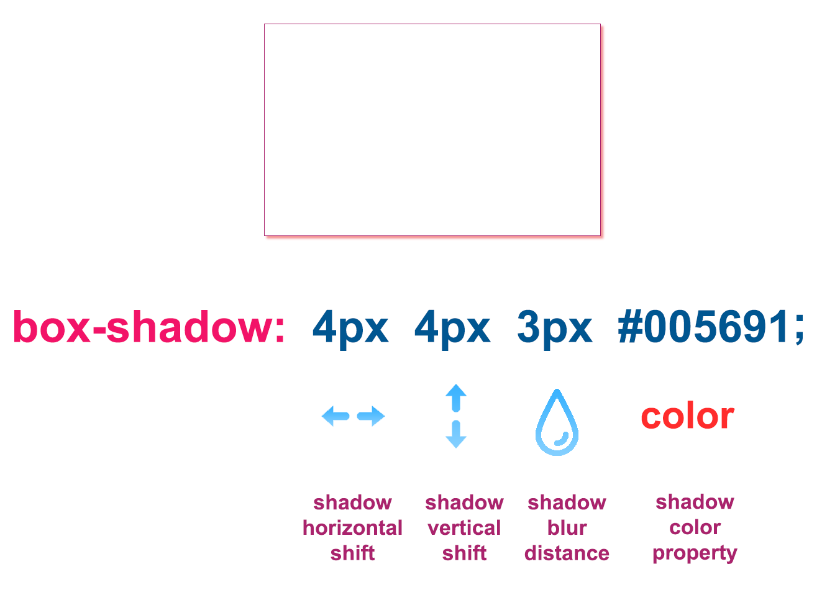

Slide 8
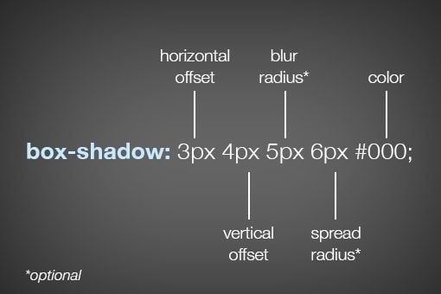
HOW BOX-SHADOW WORKS
As you can see, listed below in order, the order of values is horizontal offset, vertical offset, blur radius, spread radius and color. The first two values, horizontal and vertical offset, are fairly straightforward. Positive values will push the shadow right and downward respectively and negative values will push the shadow left and upwards.

Slide 9
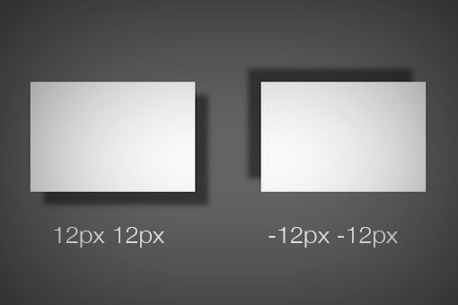

Slide 10
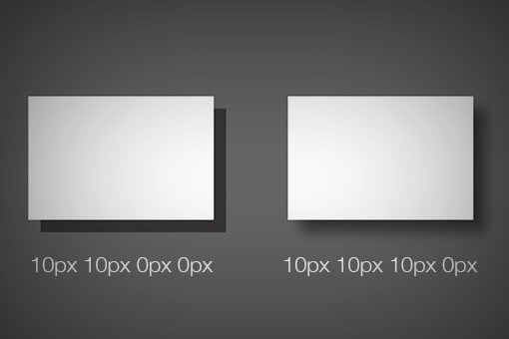

Slide 11
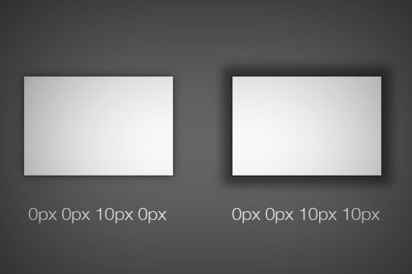

Slide 12
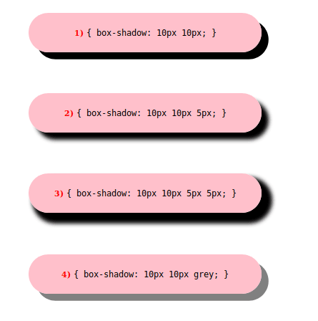

Slide 13
CSS3 box-shadow Property
The box-shadow property can be used to add shadow to the element's boxes. You can even apply more than one shadow effects using a comma-separated list of shadows. The basic syntax of creating a box shadow can be given with:
box-shadow: offset-x offset-y blur-radius color;
The components of the box-shadow property have the following meaning:
offset-x — Sets the horizontal offset of the shadow.
offset-y — Sets the vertical offset of the shadow.
blur-radius — Sets the blur radius. The larger the value, the bigger the blur and more the shadow's edge will be blurred. Negative values are not allowed.
color — Sets the color of the shadow. If the color value is omitted or not specified, it takes the value of the color property.

Slide 14
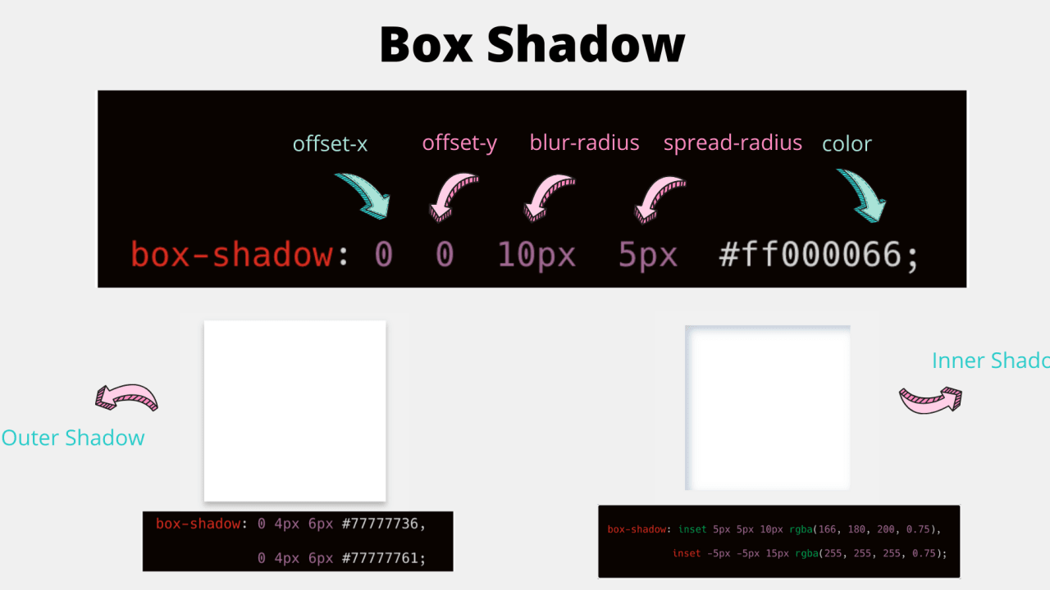

Slide 15
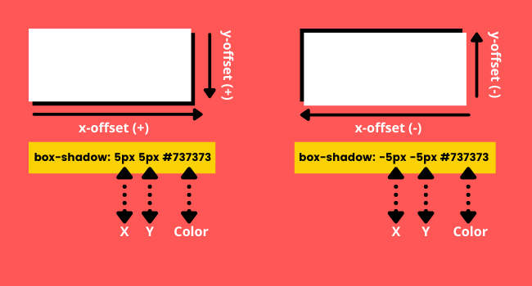

Slide 16
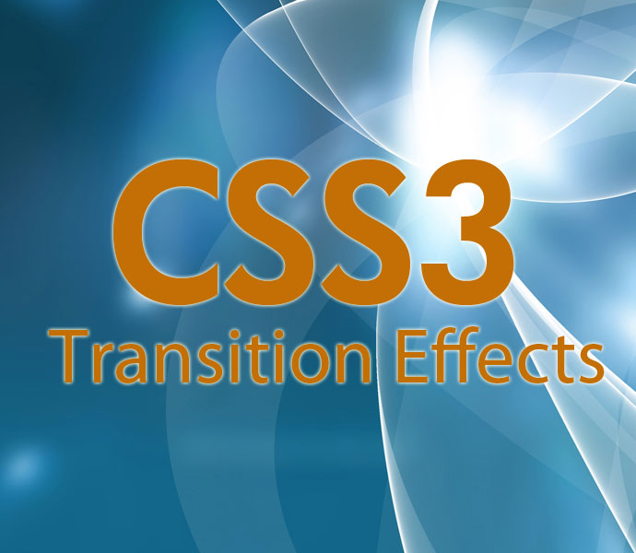

Slide 17
CSS Transitions
CSS transitions allows you to change property values smoothly, over a given duration.
With the transition effect, you can easily change the property values. You can also set a duration.
Let us try to change the height of an element:
div {
width: 150px;
height: 150px;
background: blue;
transition: width 3s;
}
div:hover {
height: 200px;
}
OUTPUT:
width will be changed from 150px to 200px during hover in 3seconds.

Slide 18
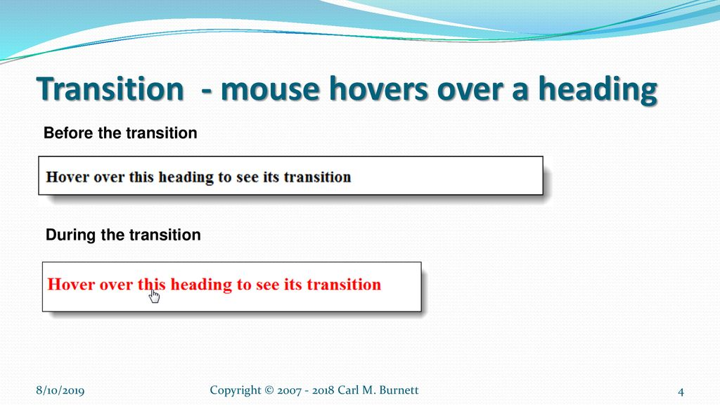

Slide 19
transform
The transform CSS property lets you rotate, scale, skew, or translate an element
translateX(x) Defines a translation, using only the value for the X-axis
translateY(y) Defines a translation, using only the value for the Y-axis
rotate(angle) Defines a 2D rotation, the angle is specified in the parameter
scale(x,y) Defines a 2D scale transformation
scaleX(x) Defines a scale transformation by giving a value for the X-axis
scaleY(y) Defines a scale transformation by giving a value for the Y-axis
rotateX(angle) Defines a 3D rotation along the X-axis
rotateY(angle) Defines a 3D rotation along the Y-axis
rotateZ(angle) Defines a 3D rotation along the Z-axis
skew(x-angle,y-angle)
Defines a 2D skew transformation along the X- and the Y-axis
skewX(angle) Defines a 2D skew transformation along the X-axis
skewY(angle) Defines a 2D skew transformation along the Y-axis

Slide 20
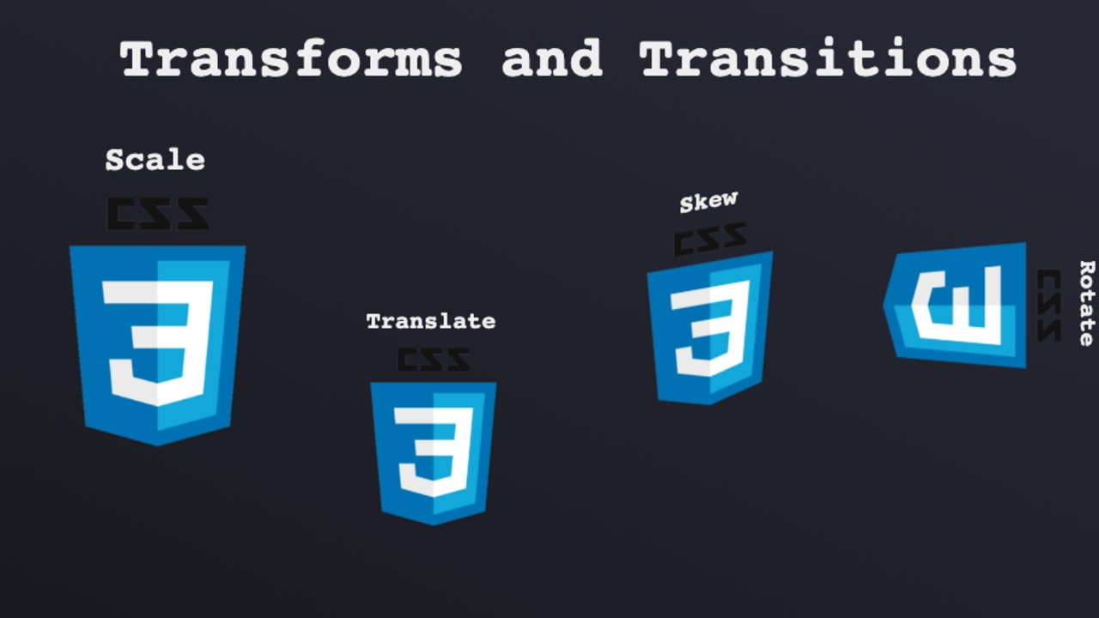

Slide 21
scale()
The scale() CSS function defines a transformation that resizes an element on the 2D plane. Because the amount of scaling is defined by a vector, it can resize the horizontal and vertical dimensions at different scales.
transform:scale(2);
rotate()
The rotate() CSS function defines a transformation that rotates an element around a fixed point on the 2D plane, without deforming it
transform: rotate(90deg);
skew()
The skew() CSS function defines a transformation that skews an element on the 2D plane.

Slide 22
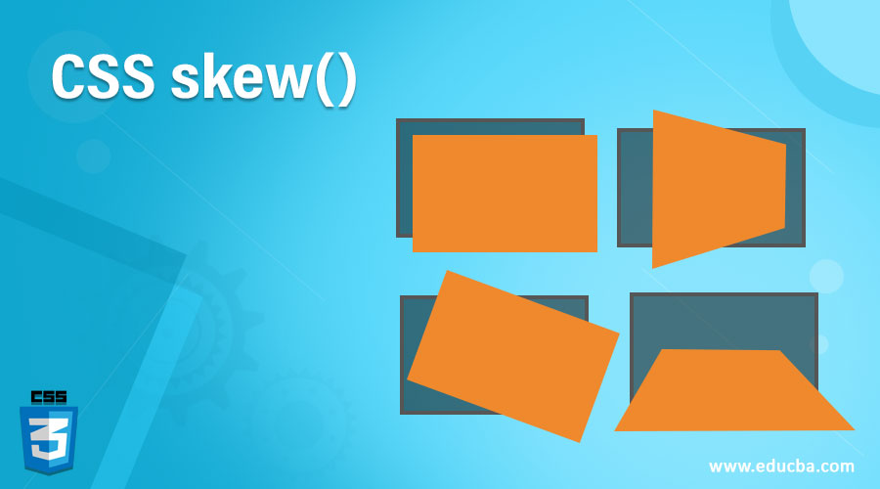

Slide 23
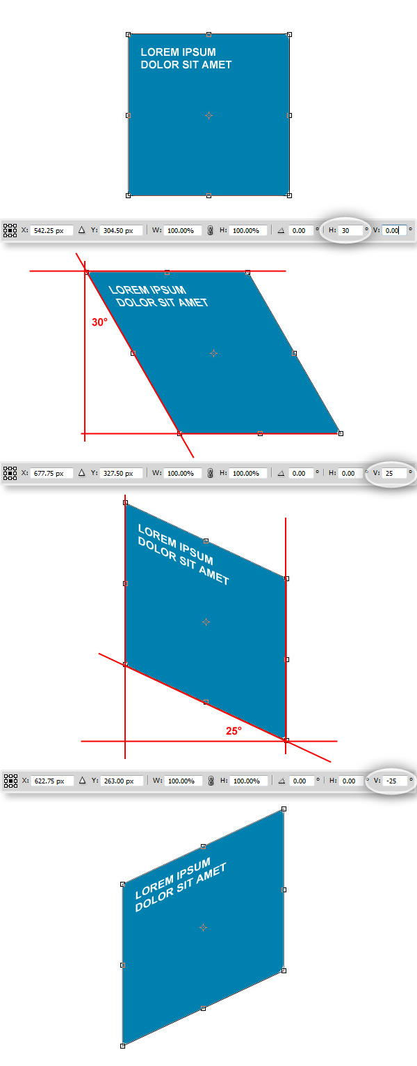

Slide 24


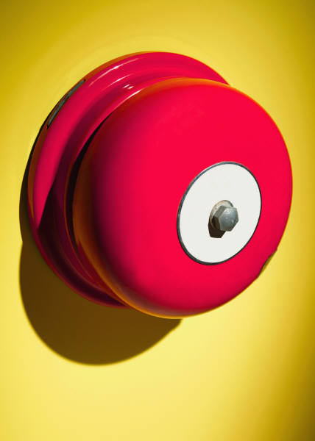
Thank You

